Slide 1
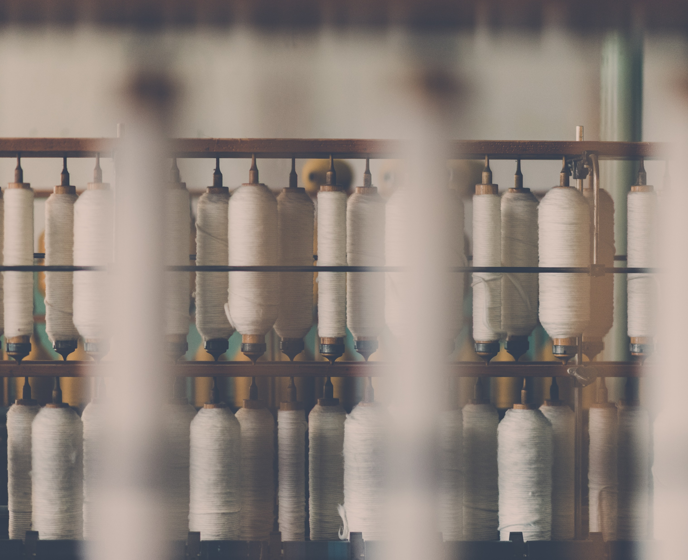
Cotton Market Trend Prediction
Artificial Intelligence Based Solution to Forecast Cotton Market
01

Slide 2
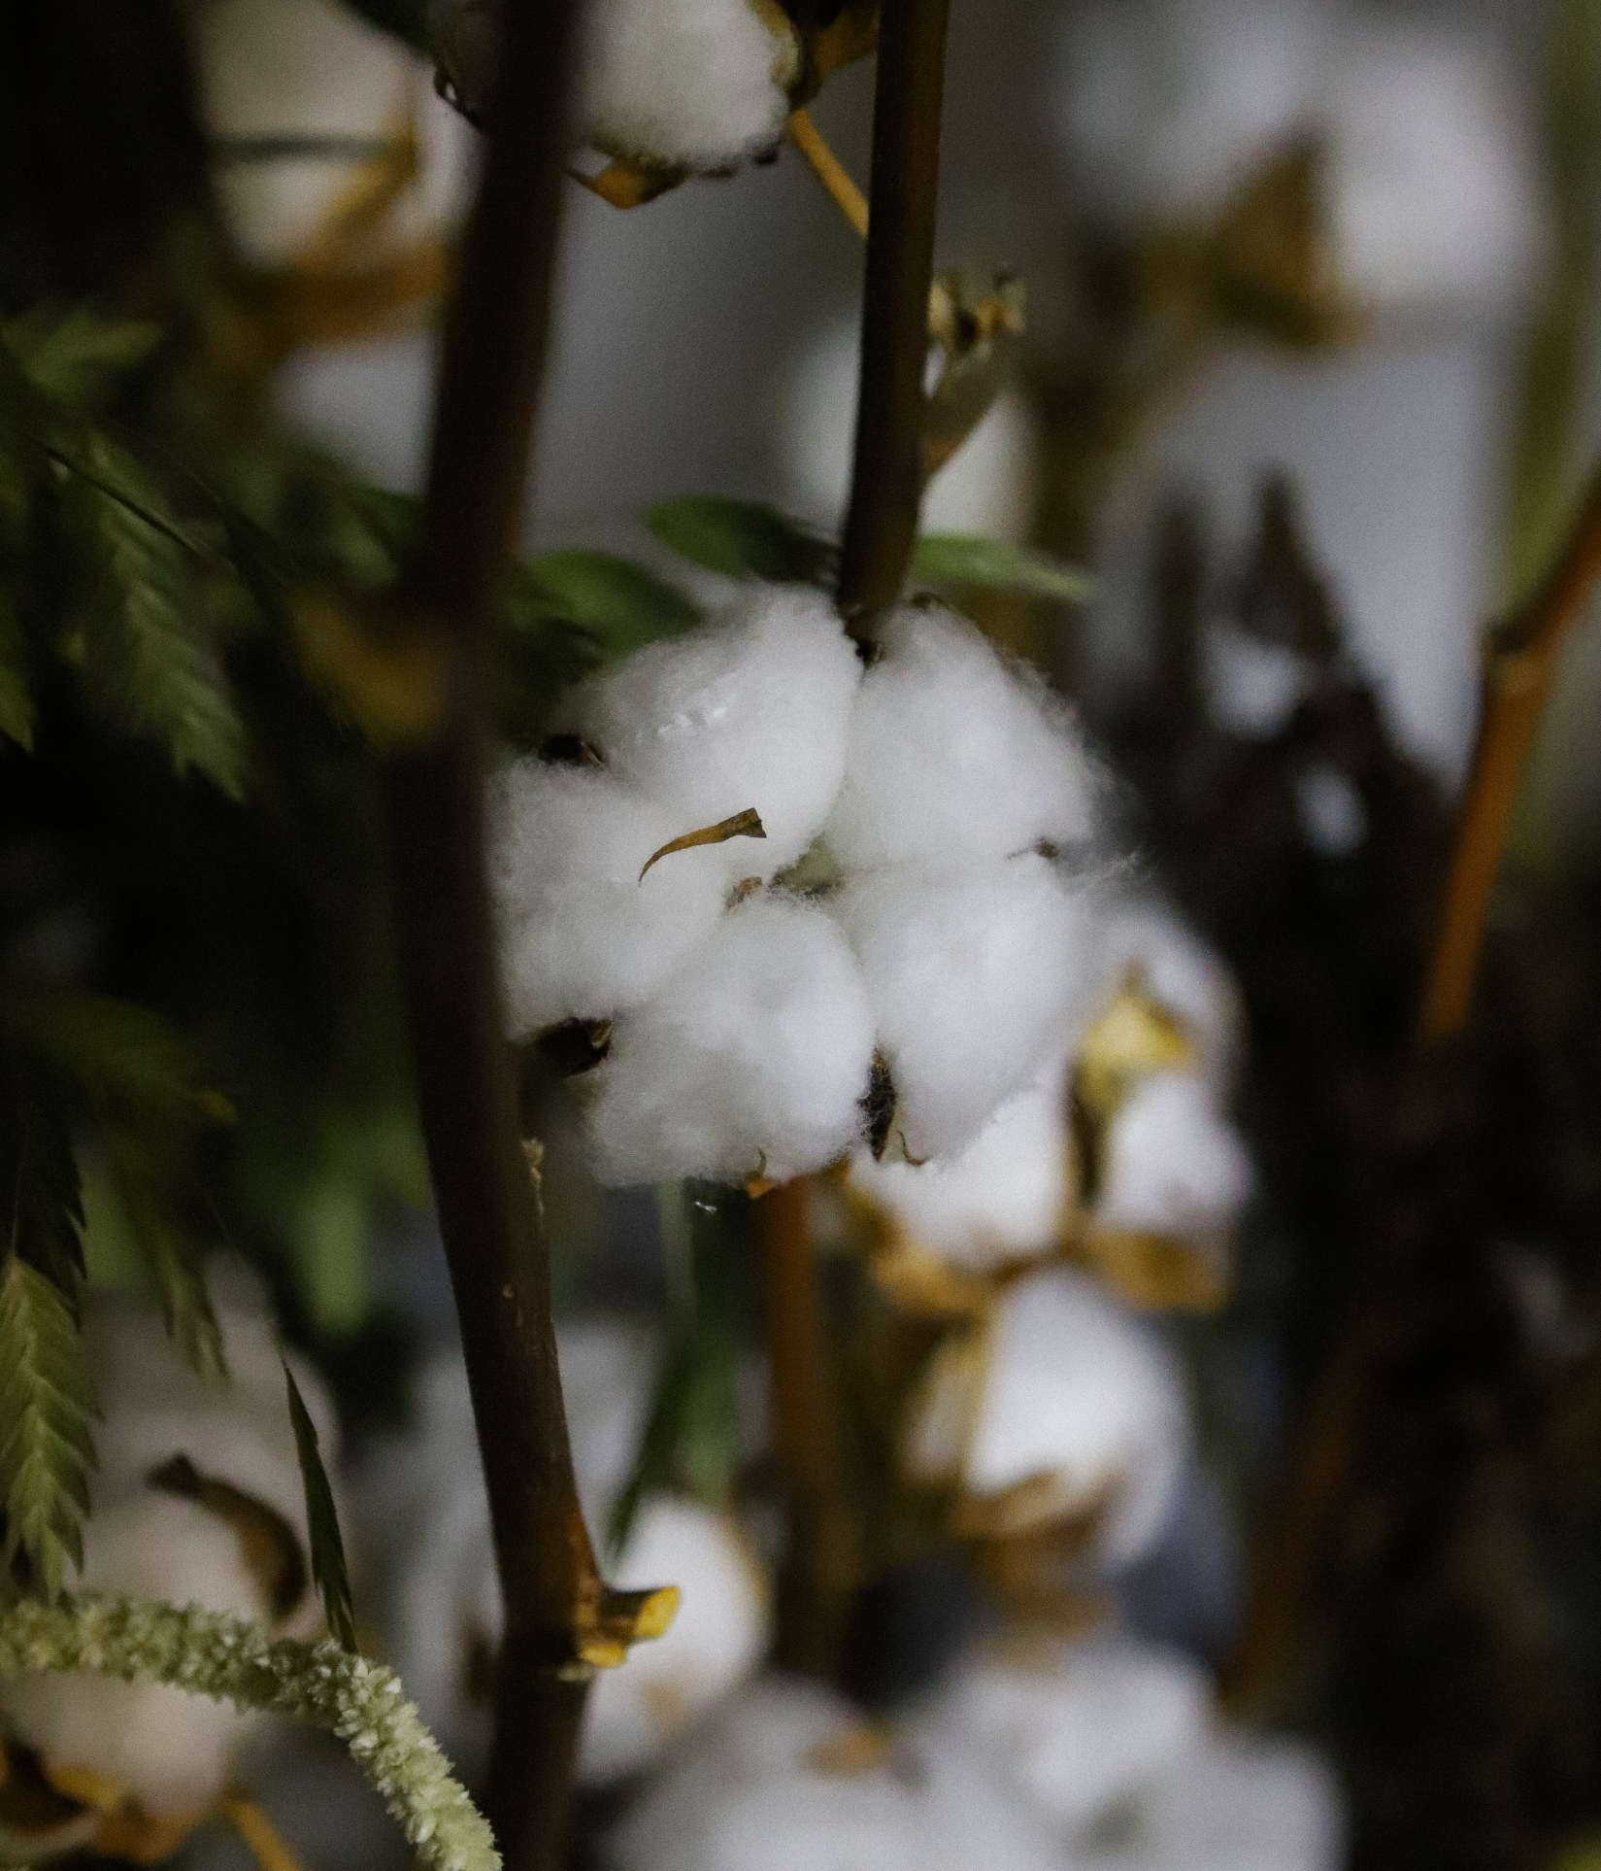
Problem Statement
Artificial Intelligence based Solution which may calculate the probability of future market trend based on past years data and suggest a suitable pricing model for the sale of cotton .
AR256
Jute Board of India, Textile Ministry of India

Slide 3




The Most Essential crop.
It plays a major role in sustaining the livelihood of an estimated 5.8 million cotton farmers and 40- 50 million people engaged in related activities such as cotton processing and trade.
25%
Total global fibre production.
126.07 lakh hectares
India
one of the most important cash crops
land under cotton cultivation
(highest in the world)
accounts for more than 20%
of the total production .

Slide 4
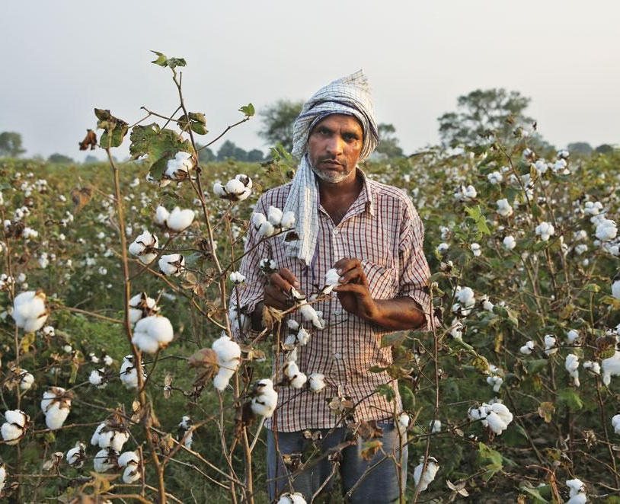
Essence of idea

Slide 5



ESSENCE
EDUCATION
Volatility
lack of knowledge and unawareness about the tools/technologies available .
rapid and unpredictable changes in cotton trends .
Wrapping up to the Volatile nature of cotton i.e. Fluctuation in cotton prices, it was not possible days back to check or verify for the prices of a commodity that can help fellow traders and farmers to grow their bussiness .
ISSUE
Data
Lack of digitized climatological and Market movement data.

Slide 6

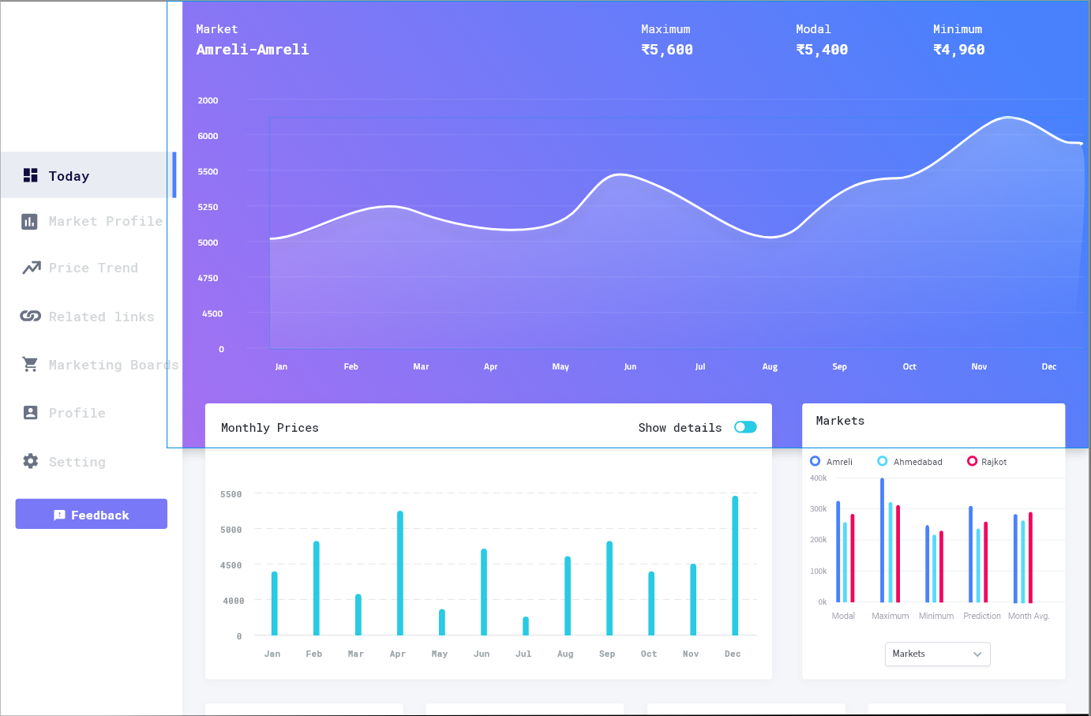



Analysis
OUR WEBSITE
Analyse the past years market trends to forecast future trends.
October - December
Nowadays , due to the emerging IT fields , trends and innovation in tools and technologies , we have data available on fingertips and that enables us to check on or verify the data whenever or wherever we want , the tasks that seemed impossible earlier can be solved within no time.
It Industry
With the emerging IT fields , trends and
innovation in tools and technologies , we have enough processing capabilities to handle large chunk of data.

Slide 7

Tools and technologis

Slide 8
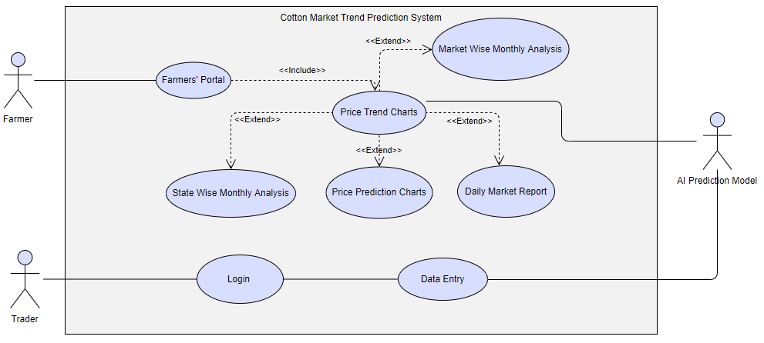
Use-case diagram

Slide 9



Technology stack…
Machine Learning Libraries
Frontend Libraries
Database
Tools and technologies

Slide 10
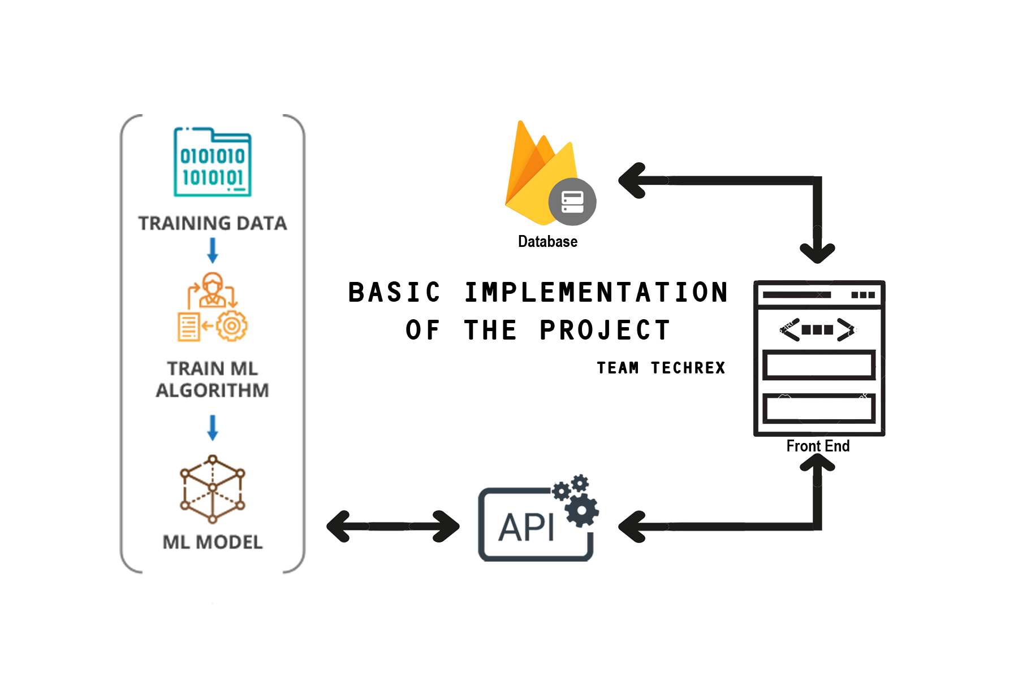
Approach
A trained model which keeps on improving the accuracy with time is implemented on backend. A Django based rest-API which takes care of data transmission between Backend and Frontend.

Slide 11

Machine learning.
Basic Idea of ml model to predict the Realtime market Movement

Slide 12
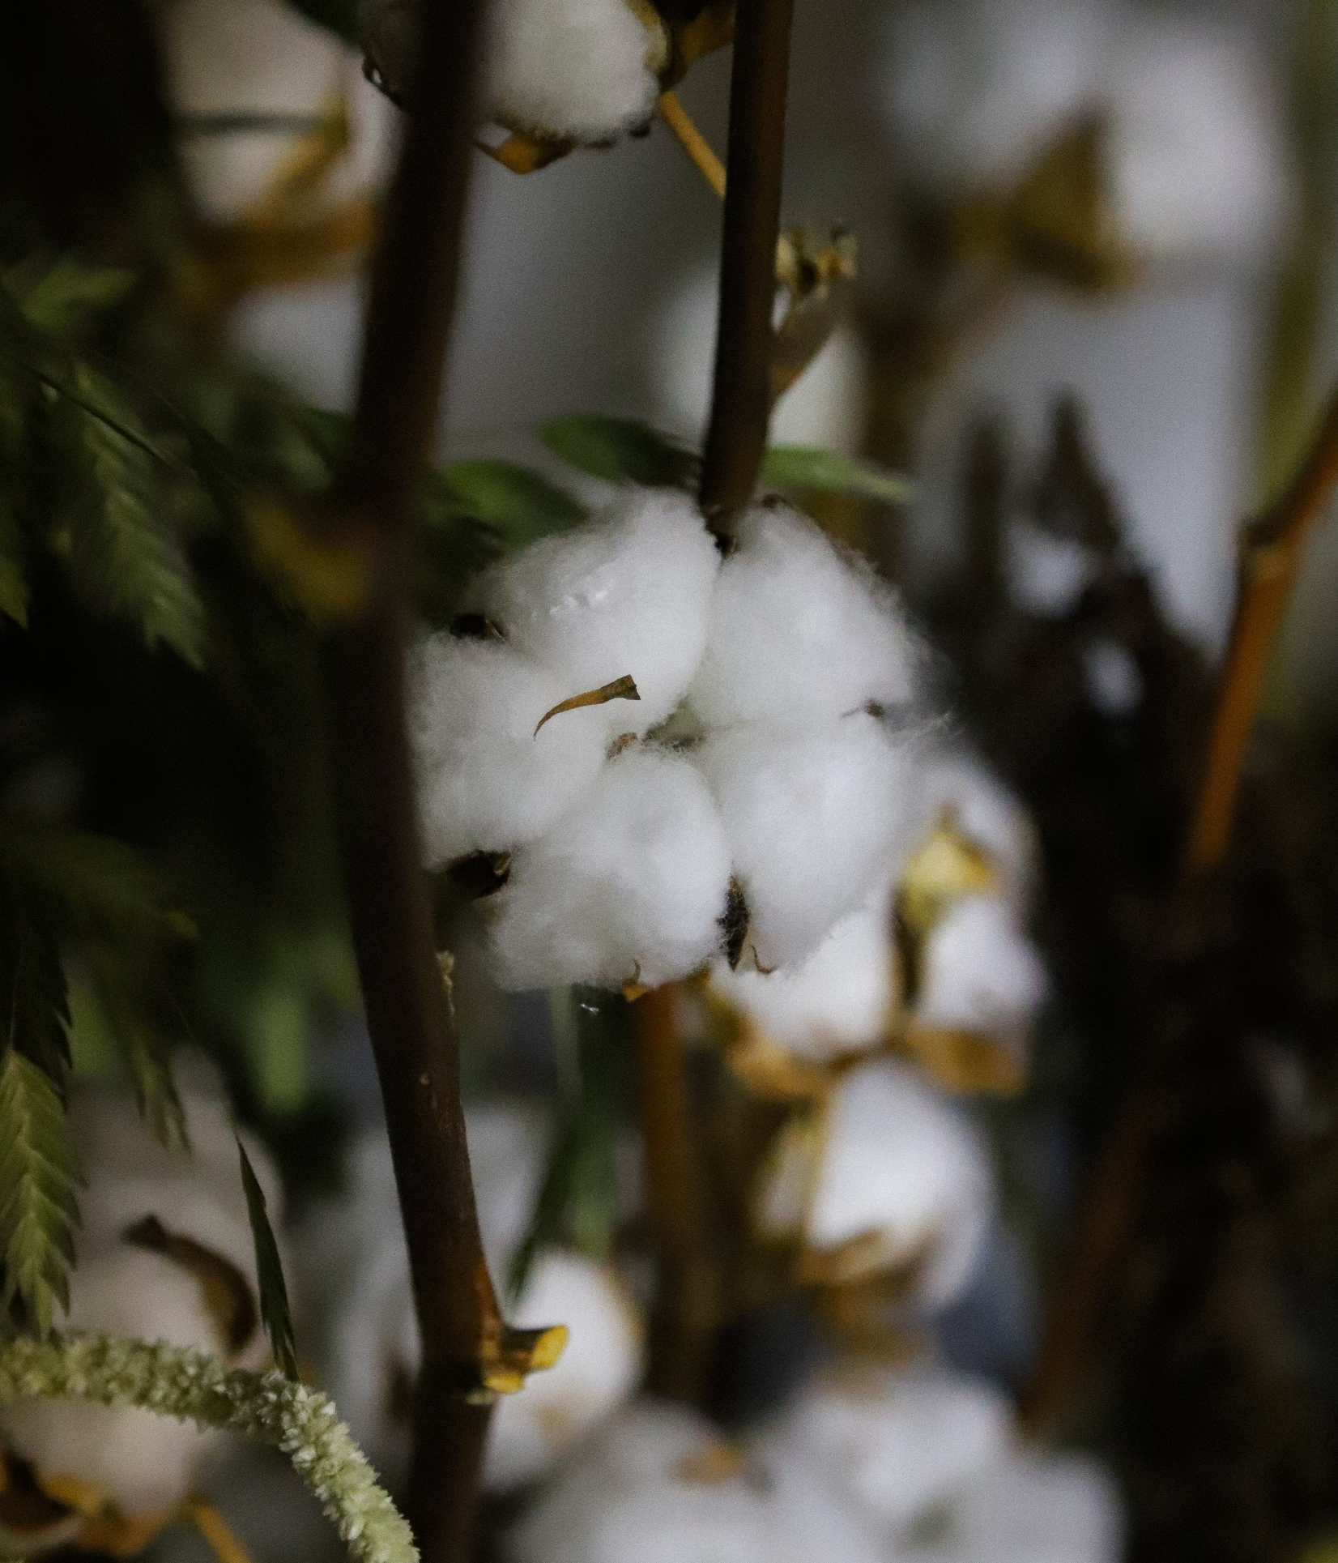
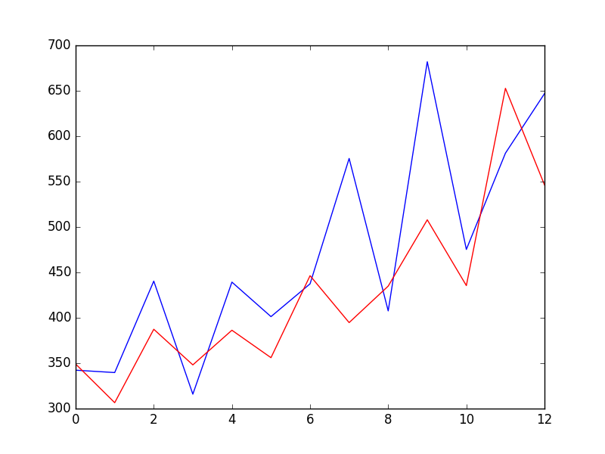
AR I MA
Integration
Moving Average
AutoRegressive

Slide 13
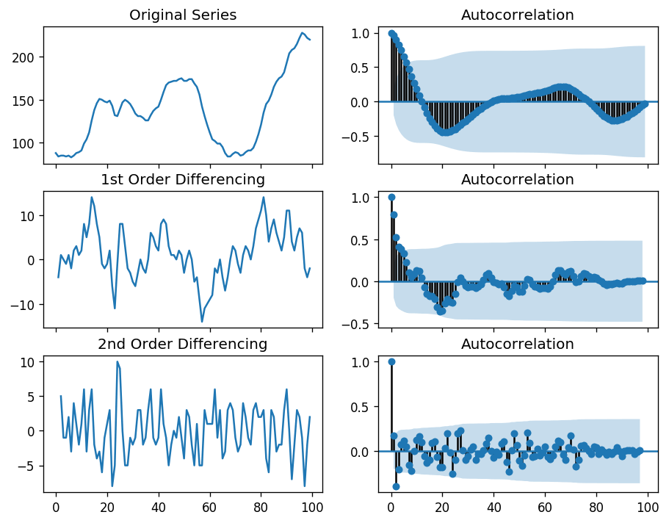
Integration.
Performing Y(t) = Y(t) – Y(t-1) Basic formula to Transform a trend to Stationary.
Second Order Diff
First order Diff
Original

Slide 14

Project planning

Slide 15
Gantt Chart
20 DEC
10 JAN
20 JAN
30 JAN
10 FEB
20 FEB
29 FEB- 15 MAR
Data Collection and UI Design
Research and Training
Design of an efficient ML Model
Development
Testing
Implementation

Slide 16

Meet our ambitious Team
17DCS062
18DCS064
Rutvik Shiyani
Anjali Patel
Leader
Machine Learning Developer
UI Designer and Frontend Developer
17DCS064
17DCS011
Akshay Sorathia
Amit Dubey
Cloud Manager and Backend Developer
Project Designer and ML Developer
A team that can achieve anything when they stick together kind of like Avengers ;-)
17DCS017
17DCS049
Mahavir Gohil
Takshil Patel
UI Designer and Frontend Developer
Database and Security Manager

Slide 17


Thank You.
Prosperous farmers mean more employment, more prosperity for the workers and the businessmen of every industrial area in the whole country.
Franklin D. Roosevelt

